Slide 1
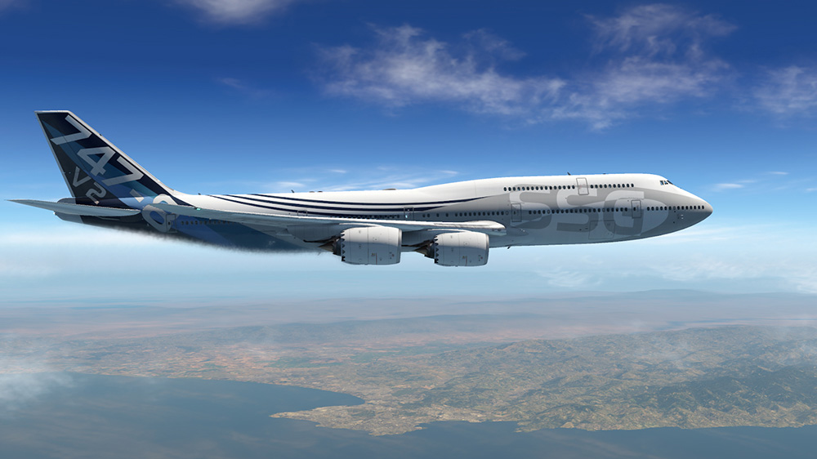
Boeing 747: Lateral MPC Control

Slide 2





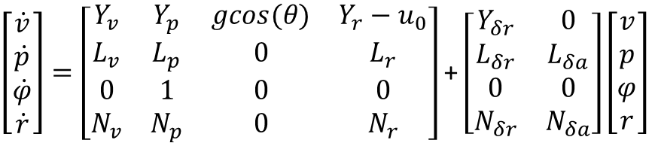









Lateral State Space Model
$\left[\begin{matrix}\dot{v} \\ \dot{p} \\ \dot{φ} \\ \dot{r}\end{matrix}\right]=\left[\begin{matrix}Y_{v} & Y_{p} & gcos(θ) & Y_{r}−u_{0} \\ L_{v} & L_{p} & 0 & L_{r} \\ 0 & 1 & 0 & 0 \\ N_{v} & N_{p} & 0 & N_{r}\end{matrix}\right]$ + $\left[\begin{matrix}Y_{δr} & 0 \\ L_{δr} & L_{δa} \\ 0 & 0 \\ N_{δr} & N_{δa}\end{matrix}\right]\left[\begin{matrix}v \\ p \\ φ \\ r\end{matrix}\right]$
Stability Derivatives
Control Derivatives
$$Y_{v}=\frac{QS}{mu_{0}}C_{yβ}$$
$L_{v}=$ $\frac{QSb}{I_{x}u_{0}}C_{Lβ}$
$$N_{v}=\frac{QSb}{I_{z}u_{0}}C_{nβ}$$
$$Y_{δr}=\frac{QS}{m}C_{yδr}$$
$$Y_{p}=\frac{QSb}{2mu_{0}}C_{yp}$$
$$L_{p}=\frac{QSb^{2}}{{2I}_{x}u_{0}}C_{Lp}$$
$$N_{p}=\frac{QSb^{2}}{2I_{z}u_{0}}C_{np}$$
$$L_{δr}=\frac{QSb}{I_{x}}C_{lδr}$$
$$L_{δa}=\frac{QSb}{I_{x}}C_{lδa}$$
$$Y_{r}=\frac{QSb}{2mu_{0}}C_{yr}$$
$$N_{p}=\frac{QSb^{2}}{2I_{z}u_{0}}C_{nr}$$
$$L_{p}=\frac{QSb^{2}}{{2I}_{x}u_{0}}C_{Lr}$$
$$N_{δr}=\frac{QSb}{I_{z}}C_{nδr}$$
$$N_{δa}=\frac{QSb}{I_{z}}C_{nδa}$$

Slide 3
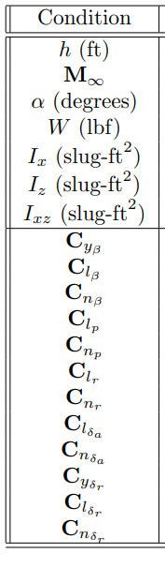
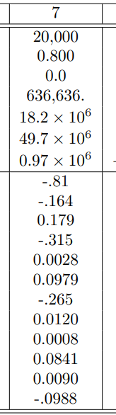






Aerodynamics Coefficients
Assumptions
Some Constants
Steady Level Flight
Mach = 0.8
Alpha = 0 deg
Alt = 20000ft
Standard Atmosphere
Constant Mass and MOI
$$S=5500 {ft}^{2}$$
chord$=27.3 ft$
$$I_{x}=18.2∙{10}^{6} slugs−{ft}^{2}$$
$$I_{z}=49.7∙{10}^{6} slugs−{ft}^{2}$$
$$I_{xz}=0.97∙{10}^{6} slugs−{ft}^{2}$$
$$W=636636 lb$$
Source: Introduction to Aircraft Stability and Control Course Notes for M&AE 5070 David A. Caughey

Slide 4


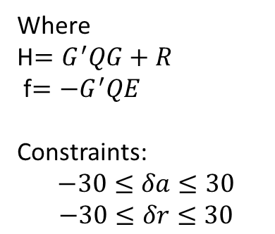

MPC Control
State Space Discretization: 0.05 sec
$$x_{k+1}=Ax_{k}+Bu_{k}$$
Prediction Time: 3 sec
$$y_{k+1}=Fx_{k}+Gu_{k}$$
Quadratic Cost Function:
$$J=E^{′}QE+U^{′}HU+2f^{′}U$$
Where
H$=G^{′}QG+R$
f$=−G^{′}QE$
Constraints:
$$−30≤δa≤30$$
$$−30≤δr≤30$$

Slide 5
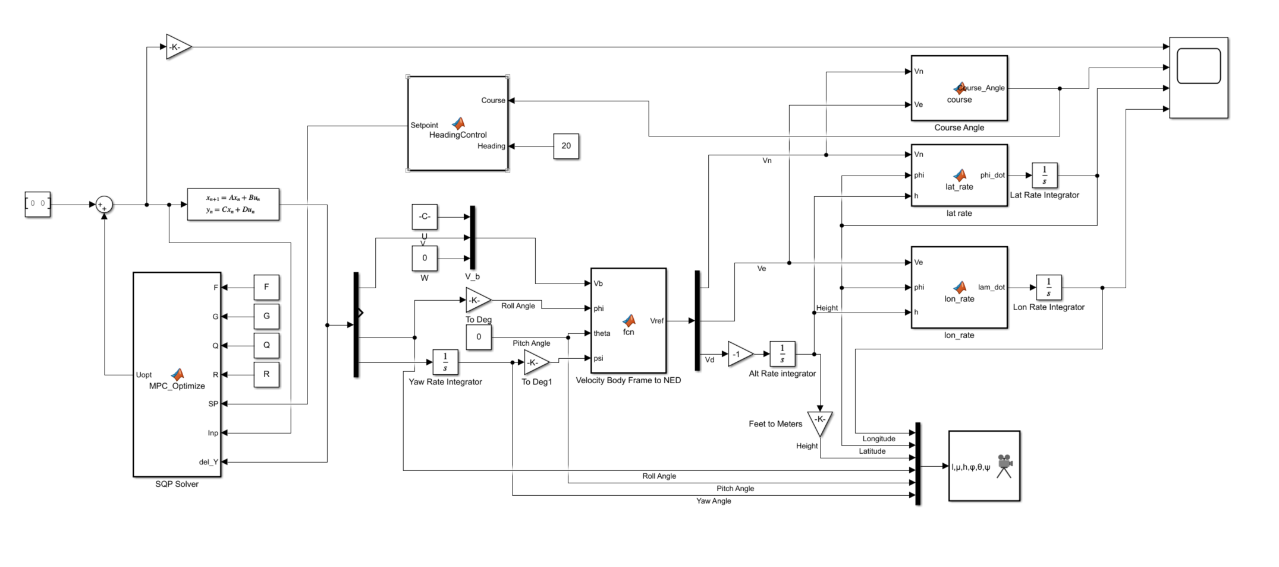
Simulink Block Diagram

Slide 6
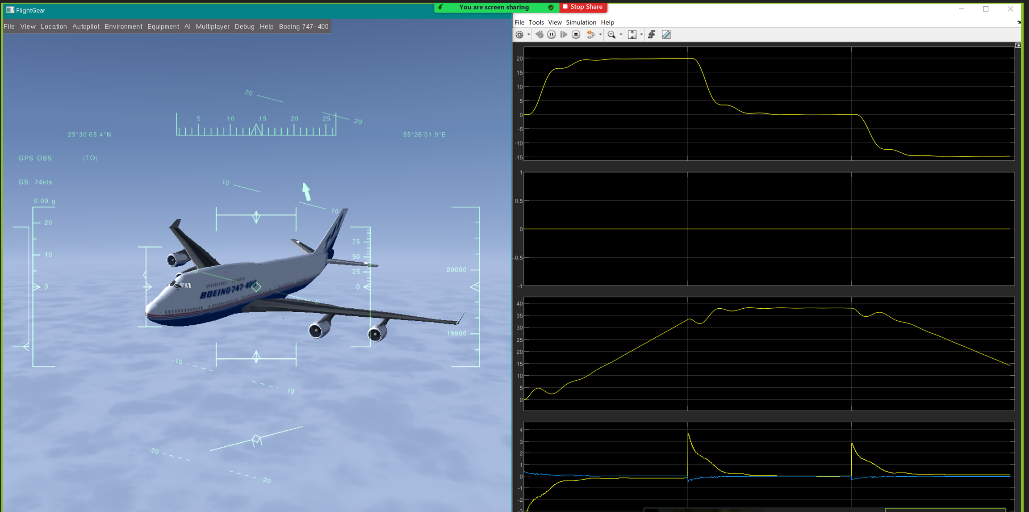
Flight Gear Interface Simulation

Slide 7
References
Introduction to Aircraft Stability and Control Course Notes for M&AE 5070 David A. Caughey
“Multivariable Receding Horizon Control of Aircraft with Actuator Constraints”
Liuping Wang: MPC Control Design and implementation

